Slide 1
Predictive modelling of Household Energy Consumption
Jyothirnayani Gurrala (YR76819)
Venkata Sai Rishitha Seelam (LX79370)

Slide 2

Introduction
Growing populations in cities like Chicago lead to difficulties in managing residential energy consumption, influenced by factors like building characteristics, occupancy, and seasonality.
Chicago is working to reduce its carbon footprint, but accurate forecasting of energy consumption remains complex.
Without reliable predictions, energy providers face inefficiencies, higher costs, and resource mismanagement.
The project aims to develop predictive models using historical energy data to forecast consumption and identify key drivers.

Slide 3

Problem statement
Urban energy consumption is influenced by complex factors like building characteristics, occupancy patterns, and seasonal changes, leading to forecasting difficulties.
Accurate models using historical data can optimize energy distribution, reduce costs, and support sustainable urban development by minimizing carbon footprints.

Slide 4
Objectives
Forecast Energy Consumption: Develop models to predict monthly and total electricity (kWh) and gas (therms) usage in residential single-family properties across Chicago. And evaluate Model accuracy and Robustness.
Identify Key Drivers: Analyze how factors such as building age, size, occupancy, and population influence energy usage.
Support Sustainable Development: Provide actionable insights to guide energy policy, urban planning, and community outreach programs aimed at reducing consumption and promoting energy efficiency.

Slide 5
Relevance to Real-World Problems
Energy Sustainability: Predicting energy usage ensures efficient resource allocation and reduces environmental impact.
Urban Planning: Helps city planners design sustainable infrastructure and policies based on energy consumption patterns.
Economic Benefits: Reduces costs for residents and governments while promoting investments in sustainable technology.
Scalability: The model can be applied to other cities, providing insights into energy consumption globally.
Community Awareness: Educates residents about energy use, encouraging sustainable behaviors and community involvement.
Environmental Goals: Supports efforts to reduce carbon emissions and optimize renewable energy utilization.
Energy Infrastructure: Assists in efficiently scaling energy grids by pinpointing high-demand areas and times.
Policy Development: Offers data-driven insights for implementing targeted energy efficiency programs.

Slide 6

The Chicago Energy Usage 2010 Dataset provides detailed information about energy consumption across Chicago neighborhoods for the year 2010. It includes data on electricity (kWh) and natural gas (therms) usage, segmented by building types and community areas. Source: City of Chicago Open Data Portal. URL:https://data.cityofchicago.org/Environment-Sustainable-Development/Energy-Usage-2010/8yq3-m6wp/data Dataset Dimensions: We have 67051 rows and 73 columns Rows: Each row represents a unique combination of community area, building type, and energy statistics. Columns: A variety of features such as building characteristics, energy usage, and demographics.
Dataset Overview

Slide 7
Column Descriptions
Column Name | Description
TOTAL THERMS | Total Gas consumption in therms in 2010.
TOTAL KWH | Total electricity consumed in 2010 in kWh.
GAS ACCOUNTS | Number of accounts with THERM information
ELECTRICITY ACCOUNTS | Number of accounts with kilowatt hour information
TOTAL POPULATION | Total population from Census 2010 report
OCCUPIED UNITS | Number of housing units that are occupied
RENTER-OCCUPIED | Number of housing units that are renter occupied
RENTER-OCCUPIED HOUSING PERCENTAGE | Percentage of occupied housing units that are renters from 'Census report
ZERO KWH ACCOUNTS | Number of accounts with 0 kilowatt hours amounts for 12 months in 2010
KWH TOTAL SQFT | Total square footage associated with the electric energy usage
THERMS TOTAL SQFT | Total square footage associated with the natural gas energy usage for Kilowatt Hours
TOTAL UNITS | Total number of housing units
AVERAGE STORIES | Average number of stories
AVERAGE BUILDING AGE | Average age of Building
COMMUNITY AREA NAME | Community name

Slide 8
Column Descriptions (Contd..)
Column Name | Description
AVERAGE HOUSE SIZE | Average household size from Census 2010 report
OCCUPIED UNITS PERCENTAGE | Occupied units percentage.
OCCUPIED HOUSING UNITS | Number of occupied housing units from 'Census 2010 report
BUILDING TYPE | Building Type: Residential, Commercial, Industrial
BUILDING_SUBTYPE | Building Sub-Type (6): Single Family, Multi <7, Multi 7+, Commercial, Industrial, Municipal.

Slide 9
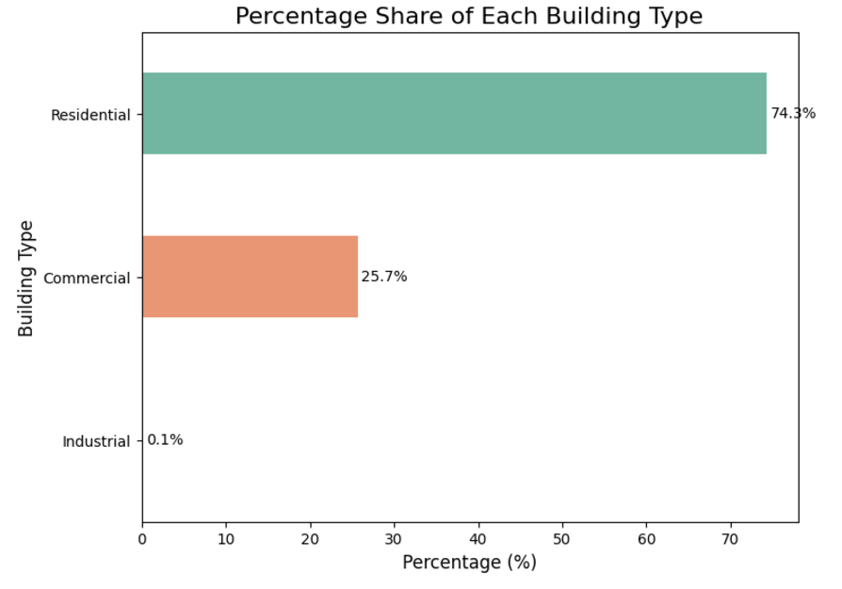
Data Analysis
There are three building types available in our dataset.
Residential: There are 49,747 (74.3%) entries labeled as "Residential,“ which is the largest group in our dataset.
Commercial: There are 17,185 (25.7%) entries labeled as "Commercial," which is the second-largest group.
Industrial: There are 42 (0.1%) entries labeled as "Industrial," which is much smaller compared to the other two categories.

Slide 10
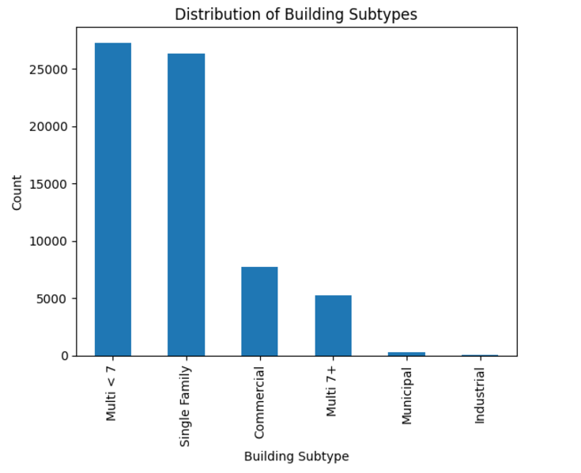
Data Analysis
There are six categories in building sub types in our dataset. In the graph we can see the distribution each building subtype.
BUILDING_SUBTYPE | COUNT
Multi < 7 | 27284
Single Family | 26366
Commercial | 7775
Multi 7+ | 5225
Municipal | 282
Industrial | 42

Slide 11
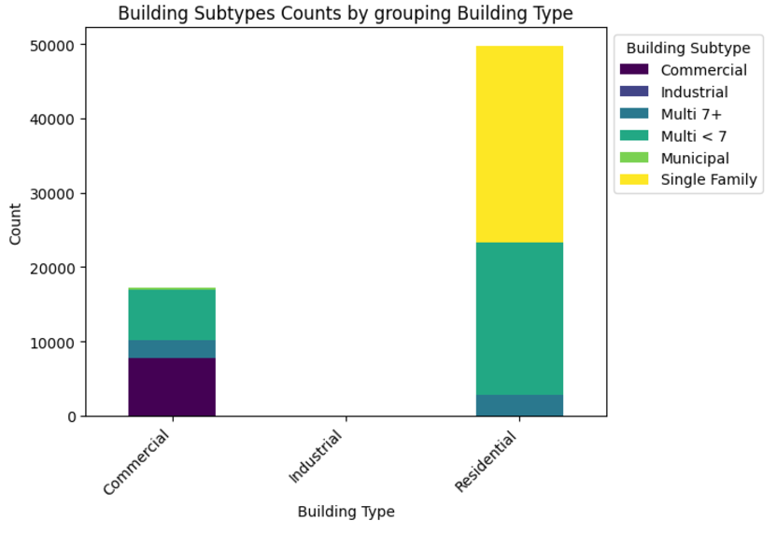
Data Analysis
We used the stacked bar chart to visualize the distribution of building subtypes within different building types (Residential, Commercial, Industrial). Each bar represents a building type, with segments showing the count of each building subtype.
It allows for easy comparison of the variety and prevalence of subtypes across different building categories.
The use of distinct colors and a clear legend enhances readability and presentation clarity.

Slide 12
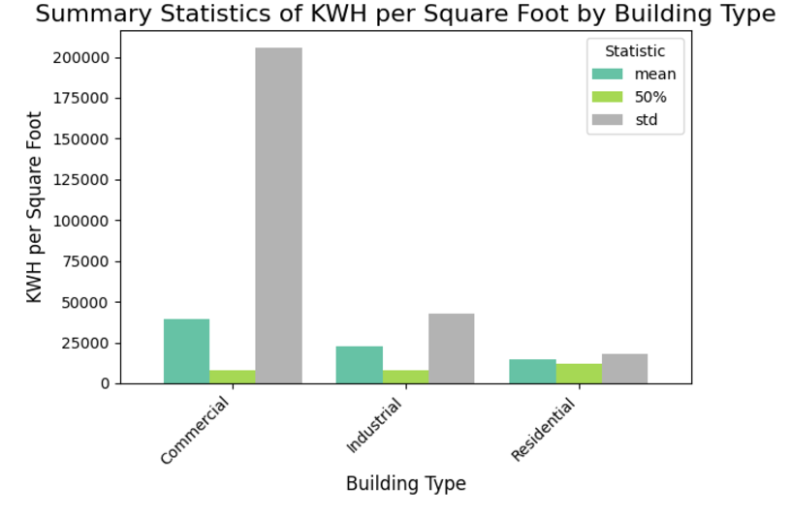
Data Analysis
The plot visualizes the summary statistics (mean, median, and standard deviation) for energy consumption per square foot ('KWH TOTAL SQFT') across three building types.
Commercial buildings have the highest energy consumption but also the most variability, likely due to differences in building size or usage patterns.
Residential buildings have the lowest energy consumption with more consistent usage, as indicated by the median being close to the mean.
Industrial buildings consume more energy than residential but less than commercial, with moderate variability in consumption.

Slide 13
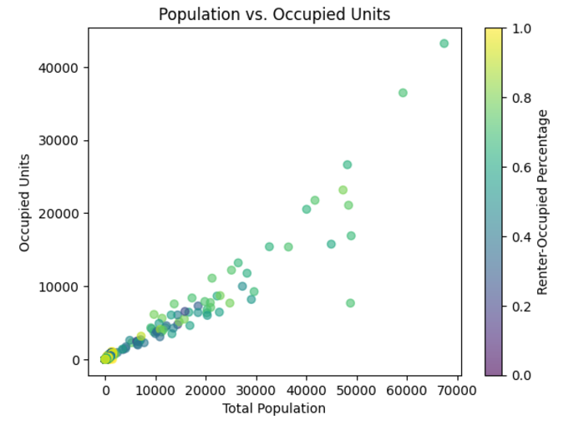
Data Analysis
We used scatter plot to visualizes the relationship between the total population and occupied units in the dataset.
It shows that areas with higher populations tend to have more occupied units, with color indicating the share of renter-occupied housing. Brighter points suggest rental-heavy areas, while darker points indicate owner-dominant regions. Clusters reflect similar community patterns, while outliers highlight unique scenarios like high vacancy or specialized housing.

Slide 14
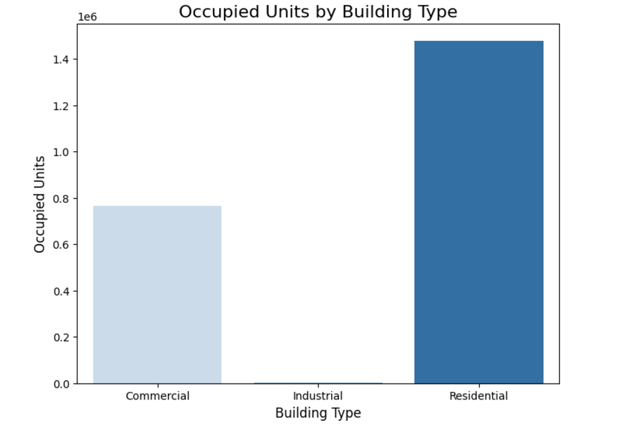
Data Analysis
The bar plot illustrates the total number of occupied units grouped by building type. Each bar represents the sum of occupied units for a specific type of building (e.g., residential, commercial, industrial)
Key Insights:
Residential buildings have the highest number of occupied units, reflecting their dominant role in providing housing.
Commercial and industrial buildings show significantly fewer occupied units, aligning with their primary non-residential purposes.

Slide 15
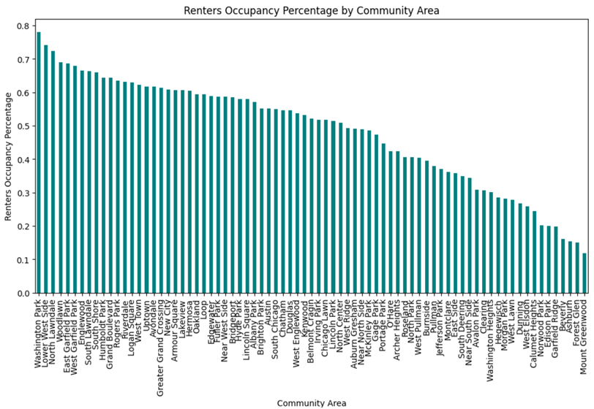
Renter Occupancy across different communities
Top Communities: Washington Park and Near North Side have the highest renter occupancy rates, exceeding 70%. These areas are likely urban hubs with significant rental demand due to economic and lifestyle factors.
Low Occupancy Areas: Communities like Mount Greenwood and Beverly show renter occupancy rates below 20%, indicating a higher prevalence of homeownership or lower rental activity.
General Trend: Renter occupancy shows a steady decline as we move across community areas, reflecting varying economic, demographic, and housing characteristics.

Slide 16
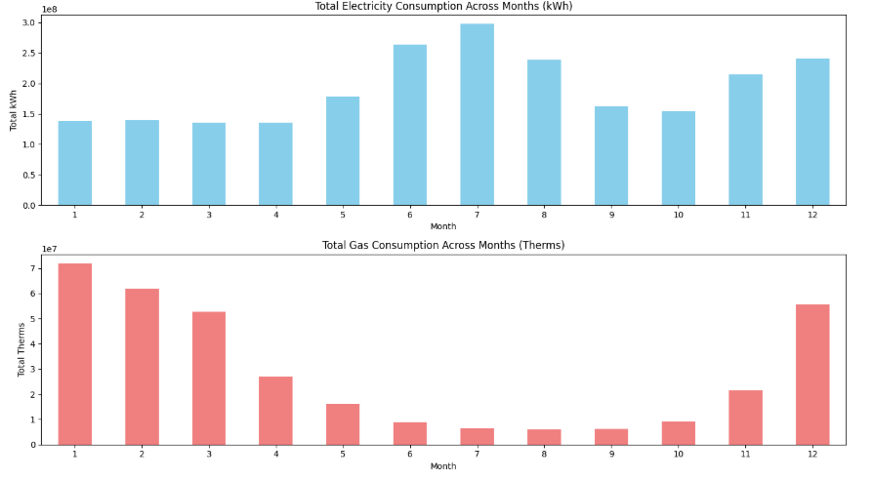
Monthly Energy Usage Trends
Both plots are created by grouping the data by the month and summing up the respective energy consumption for that month.
The higher energy consumption in July and June is due to summer temperatures, increased usage of air conditioning and cooling systems.
Similarly, heightened energy demand in December and November is influenced by the seasonal need for heating during colder months, coupled with additional usage for festive decorations and increased building occupancy during holiday celebrations.
During winter months (January to March) and especially in December, gas consumption peaks due to heightened heating needs driven by cold temperatures.

Slide 17
Data Cleaning:
We have done our analysis on various features and we observed that energy pattern is consistent for Residential – Single Family comparing to other sub-types.
Based on the analysis, residential single-family data plays a dominant role, making it ideal for insights into household energy use.
Excluding commercial and industrial buildings is justified, as these categories have unique energy demands and minimal single-family presence (only 1 for commercial and 42 for industrial). Residential data contains the largest single-family count (26,365), making it central to understanding urban household energy consumption.
By also excluding multi-family subtypes (Multi < 7 and Multi 7+), we achieve a focused view of single-family energy patterns, enabling more accurate insights for sustainable urban planning.
Both Electric accounts and Gas accounts contain ‘Less than 4’ entry. This has been removed.

Slide 18
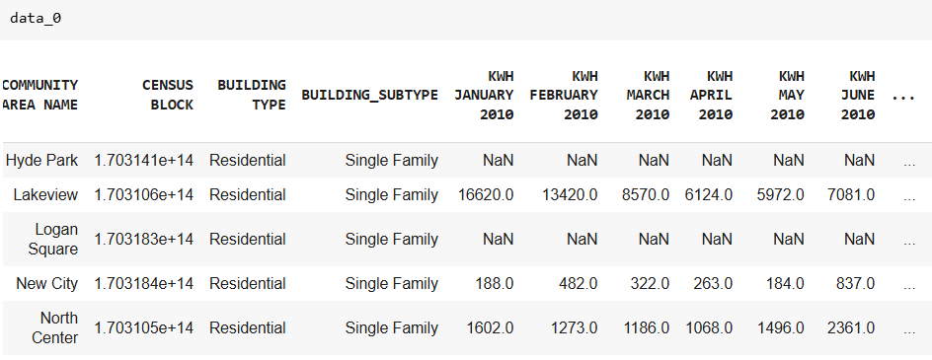
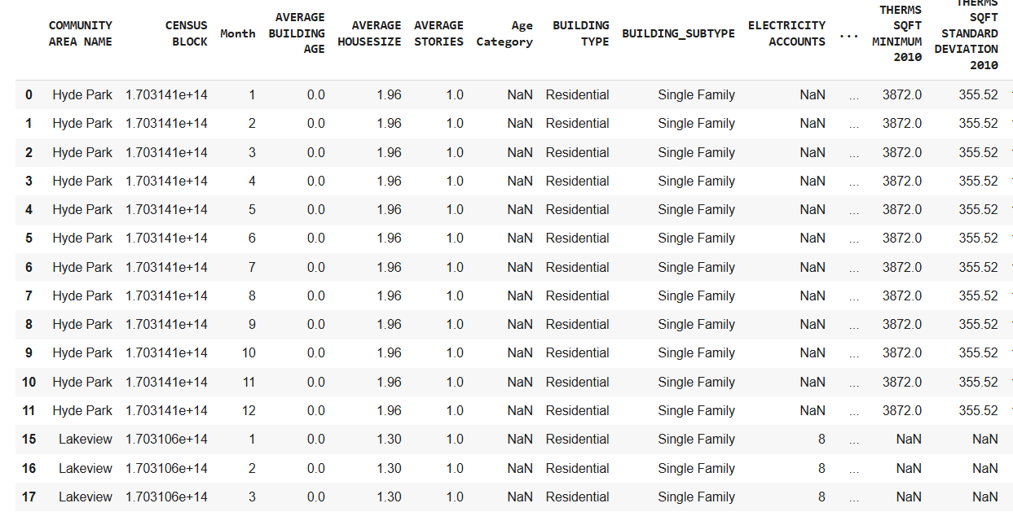
Unpivoting the Data - To bring the data into desired schema
We have changed dataset from a wide format (where each month has its own column) into a long format (where each row represents one month's energy usage for a specific location).
We have removed unnecessary summary rows like 'MEAN 2010' and cleaned up the month labels by removing the year (e.g., changing 'January 2010' to 'January').
We have converted month names (e.g., "JANUARY") to their corresponding numeric values (e.g., 1).
We have removed outliers from data and replaced nulls with the mean of respective column.

Slide 19
Data Standardization - Handling Null Values & Outliers for Accurate Insights
We have checked for the outliers and removed null values in the columns. Replaced the nulls with the mean of respective columns.
We have calculated the correlation of the features with target variables
Few features are highly co-related with others this may cause difficulty to distinguish their affect on the target variables. So we decided to 'GAS ACCOUNTS' and 'THERMS TOTAL SQFT'. This reduces redundancy, improves model interpretability, and prevents overfitting while maintaining predictive power.
So we decided to remove these columns from dataset.

Slide 20
Data Standardization and Feature selection
We have chosen chosen these below columns for data analysis
'TOTAL KWH', 'TOTAL THERMS','MONTHLY KWH', 'MONTHLY THERMS', 'Month', 'ELECTRICITY ACCOUNTS', 'GAS ACCOUNTS','TOTAL POPULATION', 'AVERAGE STORIES', 'AVERAGE BUILDING AGE','THERMS TOTAL SQFT', 'TOTAL UNITS', 'ZERO KWH ACCOUNTS', 'OCCUPIED UNITS', 'OCCUPIED UNITS PERCENTAGE', 'AVERAGE HOUSESIZE', 'RENTER-OCCUPIED HOUSING UNITS', 'RENTER-OCCUPIED HOUSING PERCENTAGE', 'KWH TOTAL SQFT
OneHotEncoder is applied to categorical columns like Month, converting them into binary features. StandardScaler is used to standardize numerical columns (e.g., energy and housing metrics), scaling them to have a mean of 0 and standard deviation of 1. The target variables are not standardized.

Slide 21
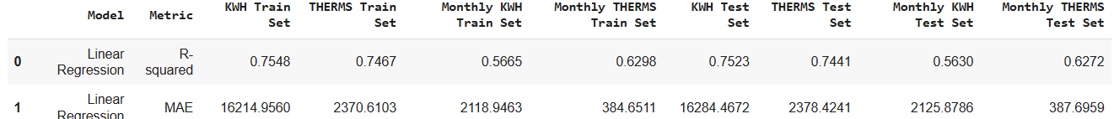
Linear Regression:
Since our target variables and dependent variable are continuous we predict a continuous outcome- we chose Linear Regression model. Below are the train and test predictions. The reason why we see the MAE in big numbers is the target variables are not standardized.
The model performs well in predicting TOTAL KWH and TOTAL THERMS, as indicated by high R-squared values (~0.75) and consistent MAE across train and test sets, showing good generalization. However, predictions for MONTHLY KWH and MONTHLY THERMS are less accurate, with lower R-squared values (~0.56–0.63), likely due to higher variability in monthly data.

Slide 22
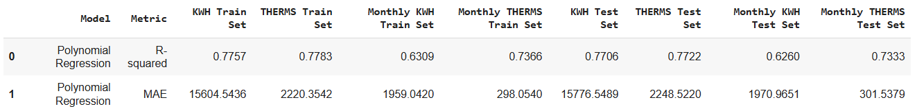
Polynomial Regression
Polynomial Regression (degree=3) outperforms Linear Regression in terms of both R-squared and Mean Absolute Error (MAE) across all target variables. The model shows a better fit to the data with higher R-squared values, indicating improved prediction accuracy.
Polynomial Regression enhances the model’s ability to capture complex relationships in the data, resulting in better overall performance. The model shows a significant improvement over Linear Regression in terms of R-squared and MAE. Additionally, the small difference between train and test metrics indicates that Polynomial Regression has effectively managed overfitting. Despite adding complexity, Polynomial Regression provides more accurate and reliable predictions.

Slide 23
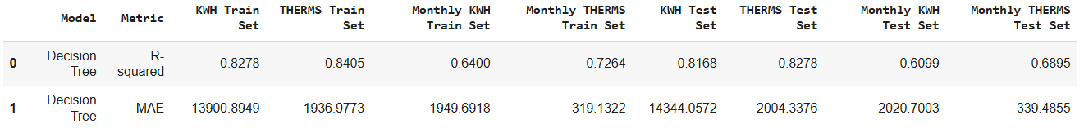
Decision Tree:
R-squared: The R-squared values for the train set are high across all target variables. On the test set, the R-squared values are slightly lower but still reasonably high, indicating that the model generalizes well.
MAE: The MAE values for the train set are relatively low, indicating good prediction accuracy on the training data. On the test set, the MAE values increase slightly, as expected, showing that the model's predictions on unseen data are a bit less accurate.
Summary: The Decision Tree model performs well overall, with good fit (R-squared values) and low prediction errors (MAE) for both training and test sets.

Slide 24
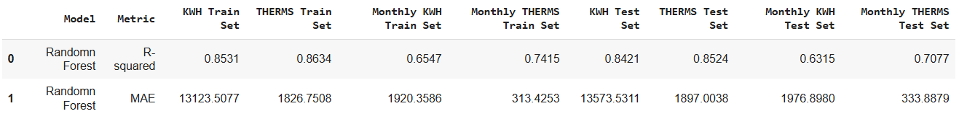
Random Forest
R-squared: The R-squared values for the train set are quite high, indicating a good fit of the model to the training data.On the test set, the R-squared values drop slightly but remain strong, showing good generalization.
MAE: The MAE values for the train set are relatively low, meaning the model has a small average error in predictions. On the test set, the MAE values increase slightly, which is typical for most models when applied to unseen data.
Summary: The Random Forest model performs well, with high R-squared values (indicating a good fit) and low MAE values (indicating accurate predictions) for both the training and test sets. The model shows some reduction in performance on the test set, which is expected when generalizing to new data, but the decrease is minimal, suggesting good generalization.

Slide 25
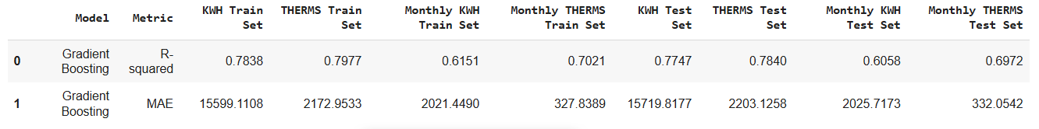
Gradient Boosting
R-squared: The R-squared values for the train set are moderate. For the test set, the R-squared values are slightly lower but still reflect reasonable model performance
MAE: The MAE values for the train set show higher errors compared to the Random Forest model, indicating that the model experiences some error increase when applied to new, unseen data.
Summary: Gradient Boosting shows decent R-squared values, but the performance is slightly lower compared to models like Random Forest in both training and test sets. The MAE is relatively high, suggesting the model may not be as precise in its predictions compared to other models, though still reasonably accurate. While there is some drop in performance from training to test set (as expected), the Gradient Boosting model demonstrates acceptable predictive accuracy.

Slide 26
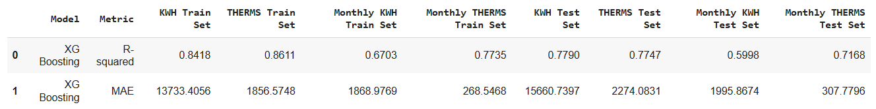
XBOOST (Extreme Gradient Boosting):
R-squared: On the training set, the R-squared values are strong. On the test set, the R-squared values drop slightly but remain decent. These values show that the model can generalize reasonably well, though some performance is lost when moving from training to test data.
MAE: The MAE values on the training set show that the model is relatively accurate. For the test set, MAE values increase somewhat, with KWH having an MAE of 15,660.74, indicating a slight drop in prediction accuracy on unseen data.
Summary: The XG Boosting model performs well on both train and test sets, with R-squared values that suggest good model fit, particularly for THERMS. The MAE values show a slight increase in error when applying the model to the test data.

Slide 27
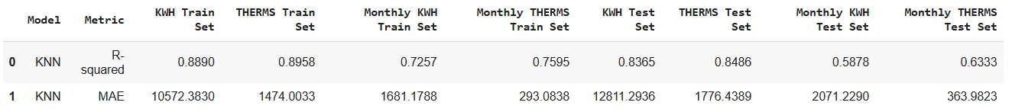
KNN
The KNN model performs well on the training set with high R-squared and low MAE but shows reduced generalization on the test set, particularly for monthly energy predictions.

Slide 28
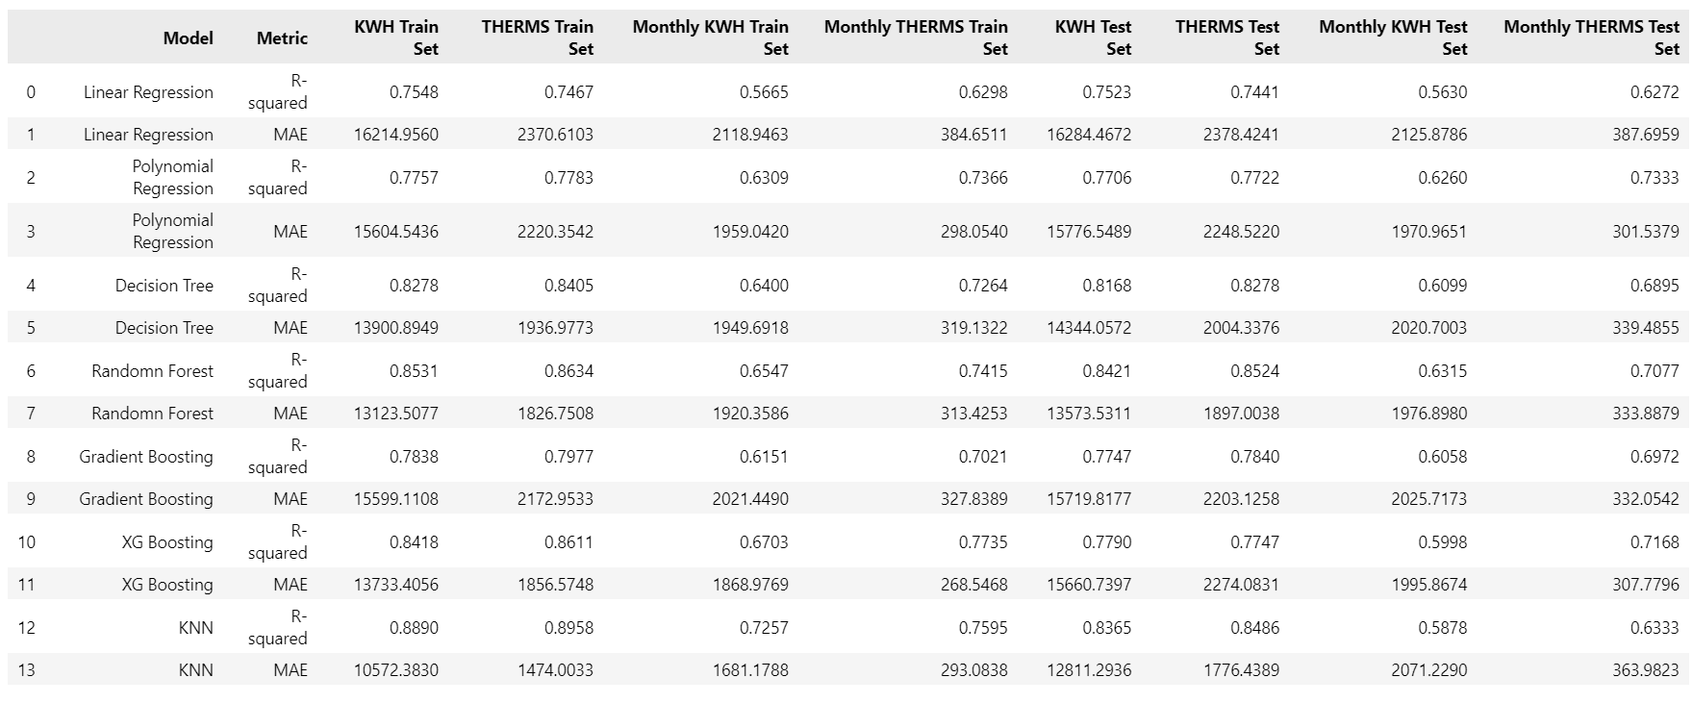
Overall Results:

Slide 29
Conclusion:
In this project, we developed and evaluated multiple machine learning models to predict household energy consumption. Among the models tested, the KNN model demonstrated superior performance, achieving higher R-squared values and lower Mean Absolute Error (MAE) compared to other models. These metrics indicate that the KNN model provides more accurate and reliable predictions, making it the most effective approach for our energy consumption prediction task

Slide 30
Future Scope
Including Real-Time Data
Extending the Dataset
Including Weather Data
Examining Complex Algorithms

Slide 31
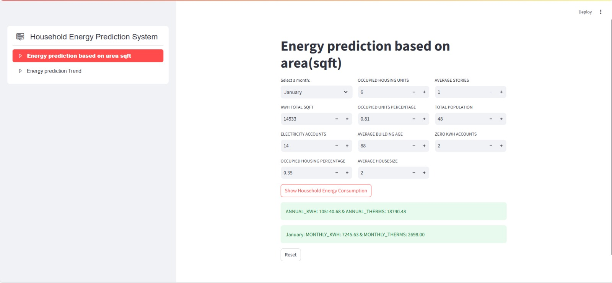
Snippet of the US Household Energy Prediction Model Web Application:

Slide 32
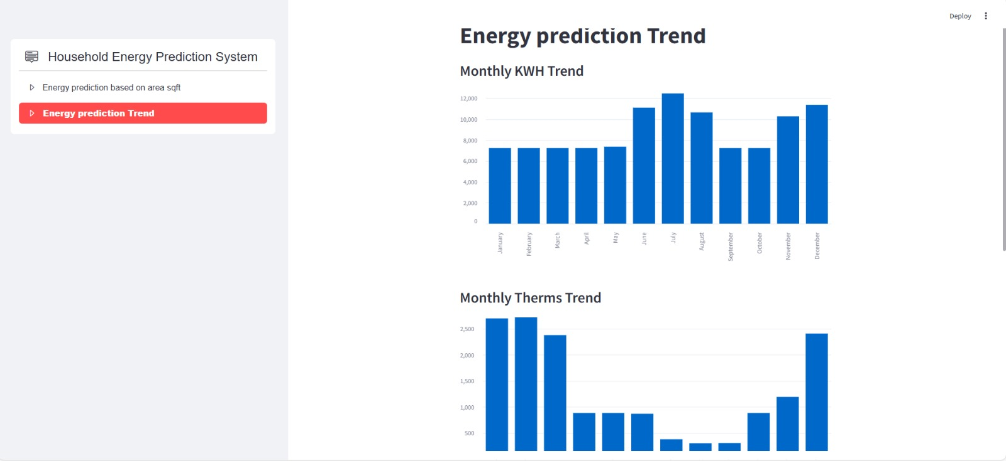
Snippet of the US Household Energy Prediction Model Web Application:

Slide 33
Thank You!

